Slide 1
Secure Data Hiding in Images Using Steganography
Presented By : Chaitanya Vasant Garud
Student Name : Chaitanya Vasant Garud
College Name & Department : Pillai College of Engineering, Navi Mumbai /CSE

Slide 2

OUTLINE
Problem Statement
Technology used
Wow factor
End users
Result
Conclusion
Git-hub Link
Future scope

Slide 3

Problem Statement
Why Secure Data Hiding is Needed
Rising Cyber Threats: Data breaches and surveillance necessitate improved security measures.
Encryption Limitations: Traditional encryption signals the presence of sensitive data, making it a target.
Need for Steganography: Hiding data in images adds an additional layer of security

Slide 4
Technology used
Libraries, Algorithms, and Platforms
Programming Language: Python 3 - The backbone of the project, enabling scripting and automation.
Libraries Used: OpenCV (image processing), Tkinter (GUI development).
File Handling & Security: Basic encryption logic for password protection
Development Platform: Windows OS, IDEs like VS Code or PyCharm for coding.
GUI Framework: Tkinter Notebook for tabbed interface, TTK for modern UI elements.
Additional Libraries: Pillow (for image handling)
Platform: Windows 11

Slide 5
Wow factors
Uses steganography to embed a message into an image without noticeable changes.
User-friendly GUI for easy encryption and decryption.
Lossless data hiding using pixel value manipulation instead of traditional cryptographic techniques.
Works on any standard image file format (PNG recommended for best results).
Unique Aspects of the Project

Slide 6

End users
Who Benefits from This Project?
Government Agencies: Utilized for secure communication and intelligence operations.
Corporations: Protects sensitive business data from industrial espionage.
General Users: Allows individuals to privately communicate without detection.

Slide 7
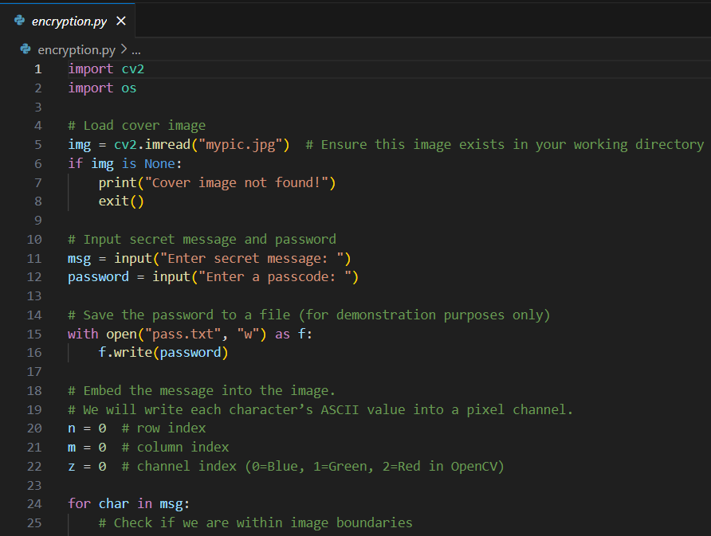
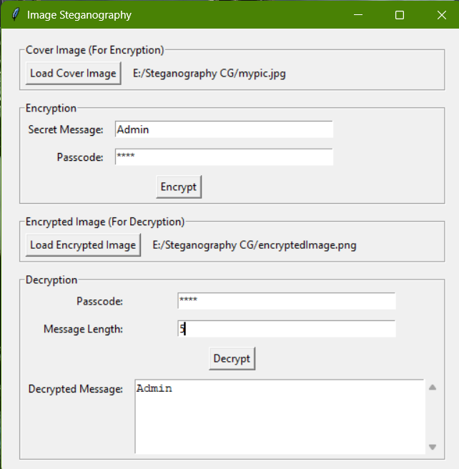
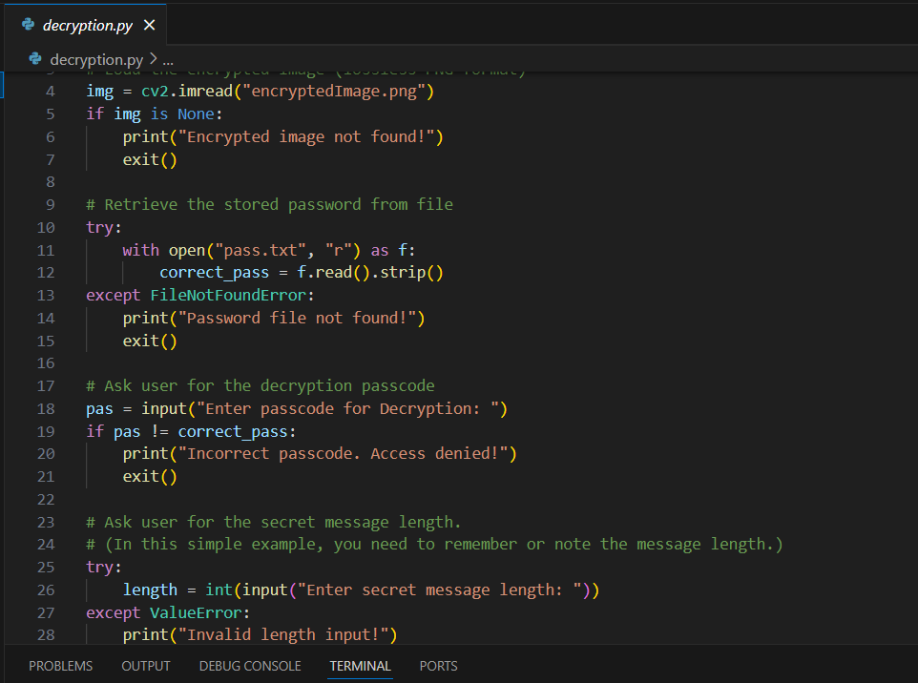

Results
Encryption Code:
GUI:
Decryption Code:
Input Image File:
Output Image File:

Slide 8



Conclusion
Key Takeaways from the Project
Enhanced Data Security
Combining encryption and steganography for improved protection.
Real-World Applications
Useful for secure communication, corporate data protection, and privacy.
Future Enhancements
Potential for Al-driven automation and quantum-safe cryptography.

Slide 9
GitHub Link
https://github.com/Chaitanyagarud/Steganography_CG.git

Slide 10
Future scope
Enhancements & Potential Applications
AI-Driven Steganography: Implementing deep learning to optimize image selection for data hiding.
Quantum-Safe Encryption: Exploring cryptographic techniques resistant to quantum computing threats.
Cloud-Based Steganography: Developing a web-based solution for secure online data hiding.
Mobile Application: Bringing steganography to smartphones for secure on-the-go communication.

Slide 11



Thank You
Presentation by Chaitanya Vasant Garud
Project Completion
Successful implementation of secure data hiding using steganography.
Open for Questions
Feel free to ask about methodology, implementation, or future work.
GitHub Repository
Find the project source code and documentation online.

